Slide 1


Slide 2
Recap
HDFS filesystem
Block
Read and Write operations
CLI commands
Network topology and rack awareness
MapReduce

Slide 3
Agenda for today
MapReduce detailed discussion
Running your first MapReduce program
Hadoop 1 vs 2: YARN

Slide 4
Job management
Submit Job
Namenode:
Job Tracker
Resource management
& Task tracking
Datanode:
Task Tracker
Datanode:
Task Tracker
Datanode:
Task Tracker
HDFS
HDFS
HDFS

Slide 5
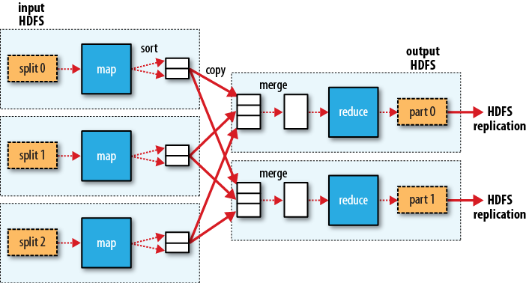
MapReduce Stages

Slide 6
Mapreduce: working example
Map
Sort & Partition
Shuffle
Merge
Reduce
2018-01-01
2018-01-02
2018-01-03
2018-01-04
2018-01-01
2018-01-02
(2018-01-01, <1,1>)
(2018-01-02, <1,1>)
(2018-01-03, 1)
(2018-01-04, 1)
(2018-01-01, <1,1>)
(2018-01-02, <1,1>)
(2018-01-03, 1)
(2018-01-04, 1)
(2018-01-01, <1,1>)
(2018-01-02, <1,1>)
(2018-01-01, 1)
(2018-01-02, 1)
(2018-01-01, <1,1,1,1,1>)
(2018-01-02, <1,1,1,1>)
2018-01-01 5
2018-01-02 4
(2018-01-01, <1,1>)
(2018-01-02, 1)
2018-01-03
2018-01-04
2018-01-01
2018-01-03
2018-01-04
2018-01-02
(2018-01-01, 1)
(2018-01-04, <1,1>)
(2018-01-03, <1,1>)
(2018-01-02, 1)
(2018-01-01, 1)
(2018-01-02, 1)
(2018-01-03, <1,1>)
(2018-01-04, <1,1>)
(2018-01-03, 1)
(2018-01-04, 1)
(2018-01-03, <1,1>)
(2018-01-04, <1,1>)
(2018-01-03, <1,1,1,1,1>)
(2018-01-04, 1,1,1,1)
2018-01-03 5
2018-01-04 4
2018-01-01
2018-01-03
2018-01-04
2018-01-01
2018-01-02
2018-01-03
(2018-01-01, <1,1>)
(2018-01-02, 1)
(2018-01-03, <1,1>)
(2018-01-04, 1)
(2018-01-01, <1,1>)
(2018-01-03, <1,1>)
(2018-01-04, 1)
(2018-01-02, 1)
(2018-01-03, <1,1>)
(2018-01-04, 1)

Slide 7
Task to node mapping
Notion of data locality

Slide 8
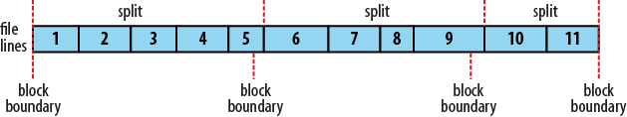
Input Splits
Blocks are of fixed size
Good chances of records being split between two block

Slide 9
MapReduce: Mapper code
public class WebHitCounterMapper extends
Mapper<Input Key, Input Value, Output Key, Output Value>
{
public void map(Input Key, Input Value, Context context) throws IOException, InterruptedException {
<MAP Logic goes here>
context.write(Output Key, Output Value) } }

Slide 10
MapReduce: Reducer code
public class WebHitCounterReducer extends
Reducer<Input Key, Input Value, Output Key, Output Value>
{ public void reduce(Input Key, Iterable<Value Data type> values,Context context) throws IOException, InterruptedException {
<REDUCE logic goes here>
context.write(Output Key, Output Value); } }

Slide 11
MapReduce: Driver Code
public class WebHitCounterMain { public static void main(String[] args) throws Exception { Configuration conf = new Configuration(); Job job = Job.getInstance(conf, "Daily Web Hit Counter");
} }

Slide 12
MapReduce: Driver Code
public class WebHitCounterMain { public static void main(String[] args) throws Exception { Configuration conf = new Configuration(); Job job = Job.getInstance(conf, "Daily Web Hit Counter");
job.setJarByClass(main.WebHitCounterMain.class); job.setMapperClass(mapper.WebHitCounterMapper.class); job.setReducerClass(reducer.WebHitCounterReducer.class); } }

Slide 13
MapReduce: Driver Code
public class WebHitCounterMain { public static void main(String[] args) throws Exception { Configuration conf = new Configuration(); Job job = Job.getInstance(conf, "Daily Web Hit Counter");
job.setJarByClass(main.WebHitCounterMain.class); job.setMapperClass(mapper.WebHitCounterMapper.class); job.setReducerClass(reducer.WebHitCounterReducer.class);
job.setOutputKeyClass(Text.class); job.setOutputValueClass(IntWritable.class); } }

Slide 14
MapReduce: Driver Code
public class WebHitCounterMain { public static void main(String[] args) throws Exception { Configuration conf = new Configuration(); Job job = Job.getInstance(conf, "Daily Web Hit Counter");
job.setJarByClass(main.WebHitCounterMain.class); job.setMapperClass(mapper.WebHitCounterMapper.class); job.setReducerClass(reducer.WebHitCounterReducer.class);
job.setOutputKeyClass(Text.class); job.setOutputValueClass(IntWritable.class);
FileInputFormat.addInputPath(job, new Path(args[0])); FileOutputFormat.setOutputPath(job, new Path(args[1])); } }

Slide 15
MapReduce: Driver Code
public class WebHitCounterMain { public static void main(String[] args) throws Exception { Configuration conf = new Configuration(); Job job = Job.getInstance(conf, "Daily Web Hit Counter");
job.setJarByClass(main.WebHitCounterMain.class); job.setMapperClass(mapper.WebHitCounterMapper.class); job.setReducerClass(reducer.WebHitCounterReducer.class);
job.setOutputKeyClass(Text.class); job.setOutputValueClass(IntWritable.class);
FileInputFormat.addInputPath(job, new Path(args[0])); FileOutputFormat.setOutputPath(job, new Path(args[1]));
System.exit(job.waitForCompletion(true) ? 0 : 1); } }

Slide 16
Programming Exercise

Slide 17
Challenges with Hadoop 1
Applications were limited to MapReduce implementations only
Namenode machine crash or maintenance activity
Namespace scaling
Backup and Recovery
Batch oriented architecture
Support for various file formats
Dual responsibilities of Job tracker
Image Ref: https://www.greycampus.com/blog/big-data/top-differences-between-hadoop-1-0-and-hadoop-2-2

Slide 18
Hadoop 2
Support for other data processing engines
High Availability
HDFS Federation
HDFS Snapshot
Introduced Streaming and Interactive analysis
Support for various file formats
Yarn

Slide 19
YARN
Yet Another Resource Negotiator
MapReduce 1 | YARN
Job Tracker | Resource Manager, Application Master and Timeline server
Task Tracker | Node Manager
Slot | Containers

Slide 20
YARN model
Image Ref: Hadoop definitive guide 4th edition

Slide 21
Pros of YARN
Scalability
Availability
Utilization
Multitenancy

Slide 22
Hadoop Installation
Standalone
Everything in one JVM. No HDFS installation
Pseudo-distributed
Mimic a distributed cluster on single physical machine
Distributed
Fully distributed cluster with multiple physical machines

Slide 23
Reference
Hadoop standalone vs pseudo-distributed
https://stackoverflow.com/questions/23435333/what-is-the-difference-between-single-node-pseudo-distributed-mode-in-hadoop
Hadoop installation differences
https://medium.com/@nidhinmahesh/getting-started-hadoop-mapreduce-hdfs-and-yarn-configuration-and-sample-program-febb1415f945
Download Ubuntu
https://www.ubuntu.com/download/desktop
Hadoop installation step by step guide
http://www.bogotobogo.com/Hadoop/BigData_hadoop_Install_on_ubuntu_16_04_single_node_cluster.php

